Slide 1
How to Submit a Change of Program Request in Banner 9

Slide 2
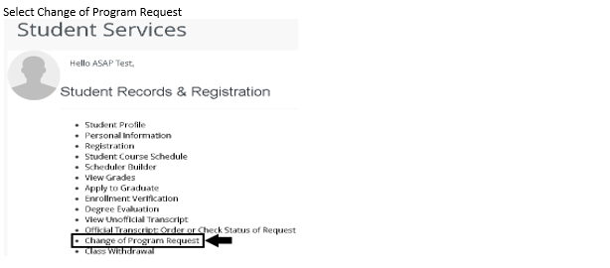
Program Request
At the bottom left select “Change of Program Request.”

Slide 3
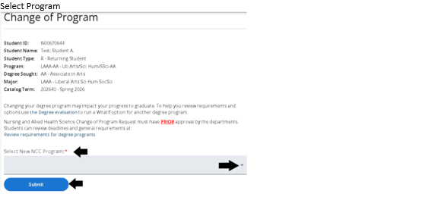
New NCC Program
Click the drop-down arrow to select your New NCC Program. Then click the blue “Submit” button.

Slide 4
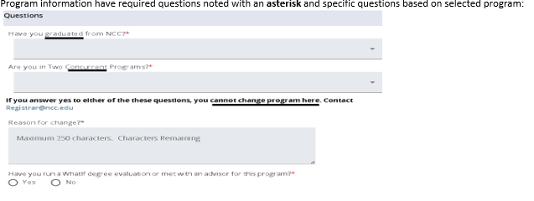
Required Questions
Use the drop-down menus to answer all the required questions.

Slide 5
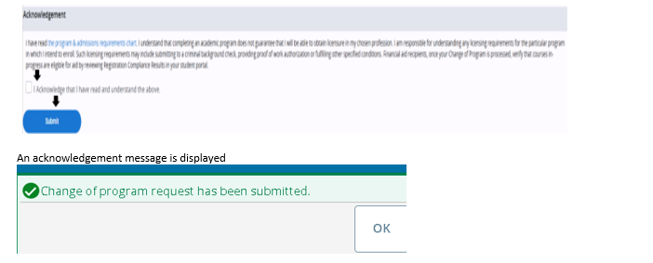
Acknowledgement Message
Confirm your Acknowledgment by selecting the box on the left. Then click the blue “Submit” button. You will then see an acknowledgement message displayed.

Slide 6
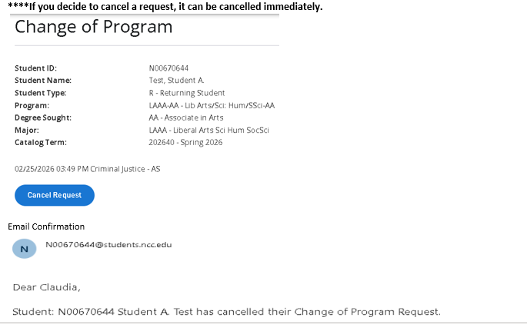
How to Cancel a Withdrawal Request
Click the blue “Cancel Request” button.

